Slide 1
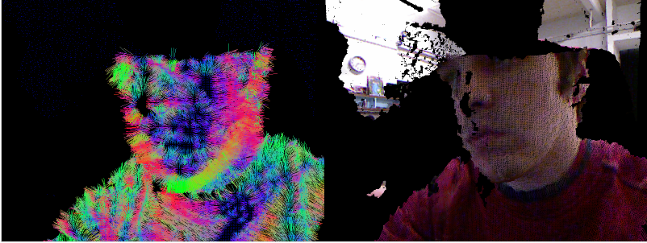
GPU-Accelerated Conversion of RGBD Images to Textured Triangle Meshes
Collin Boots and Dalton Banks

Slide 2
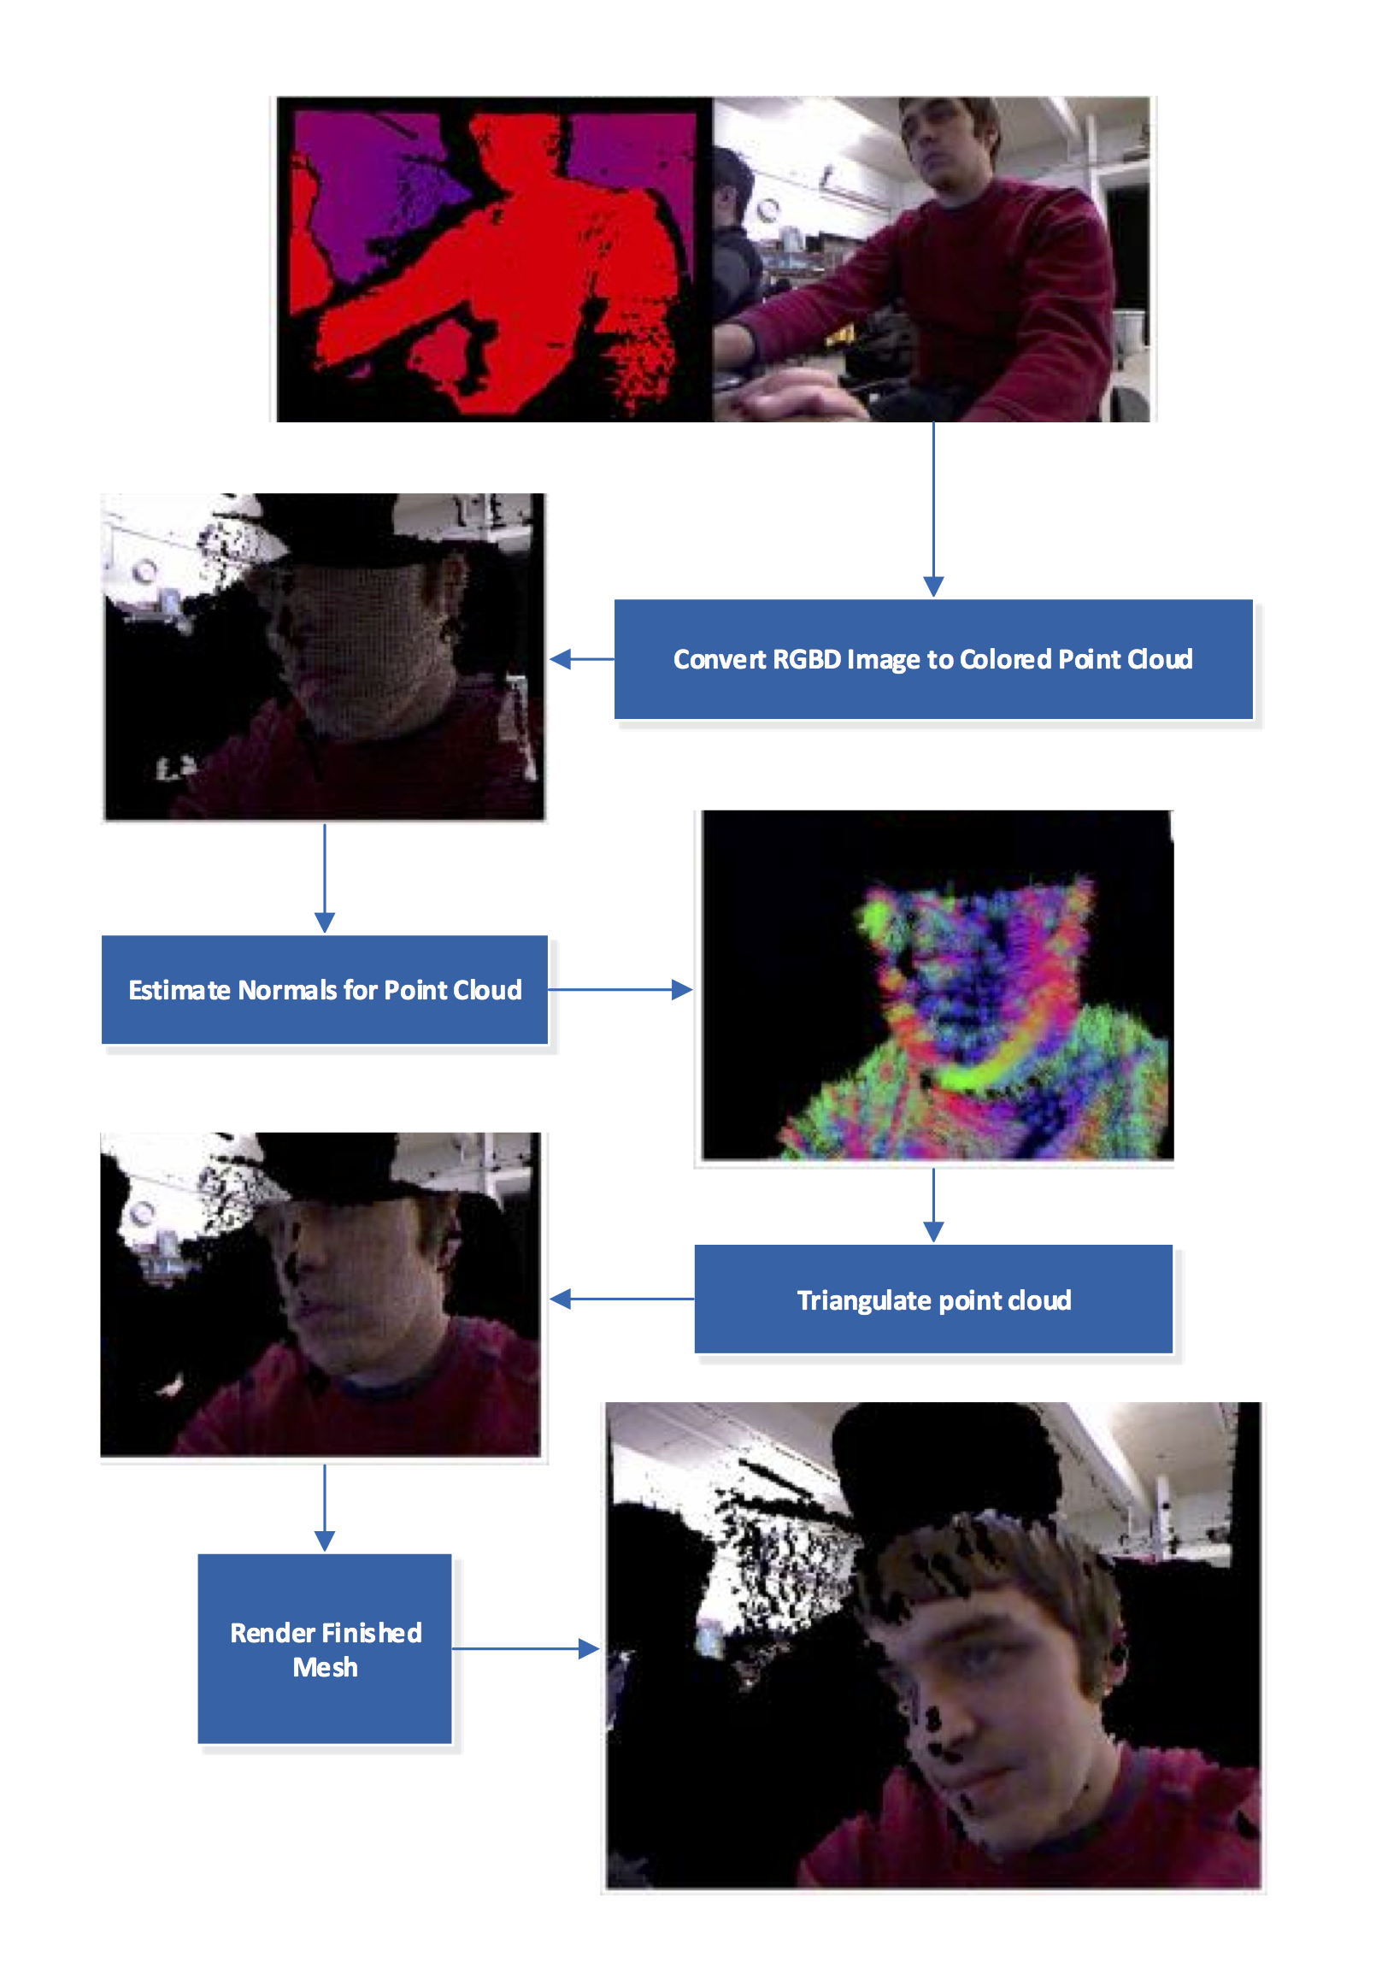
Image Processing Pipeline

Slide 3
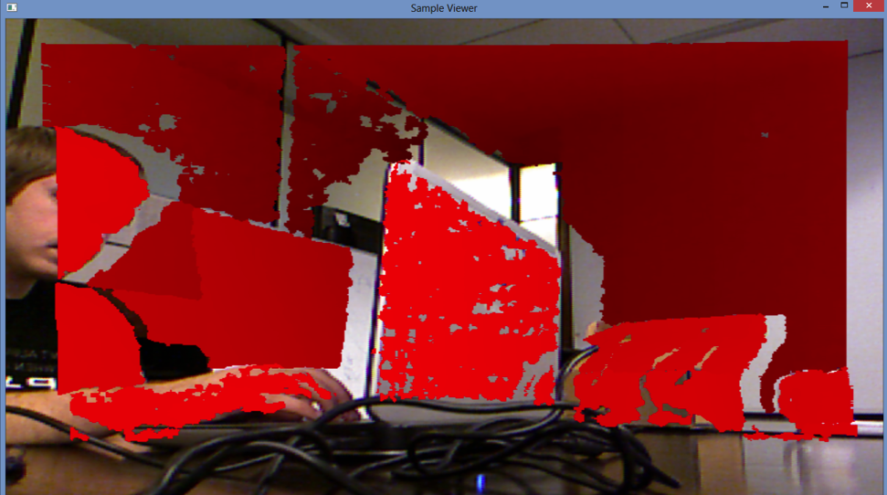
Framework
Capture, synchronize, and optionally save RGB and depth images streaming from RGB-D capture device
Display and process either live or recorded RGB-D streams
All processing and rendering doing on the GPU
Synchronized RGB and depth streams
Framework architecture

Slide 4

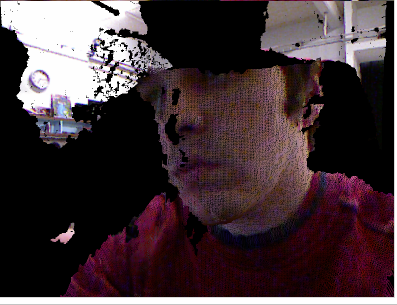
Point Cloud Reconstruction
RGB
point cloud

Slide 5
Point Normals Estimation
Identify nearest neighbors
First pass: XY image window
Second pass: 3D radius threshold
Estimate normal from NN best-fit plane using PCA
Too slow: reimplemented using averaging
Assign direction using dot-product with camera vector

Slide 6
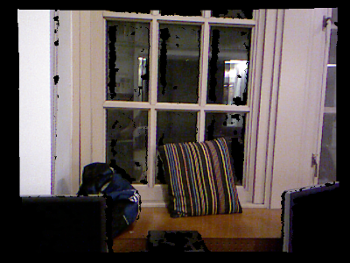
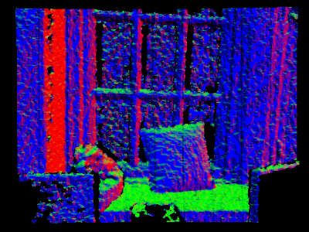
Point Normals Estimation
RGB
point normals

Slide 7
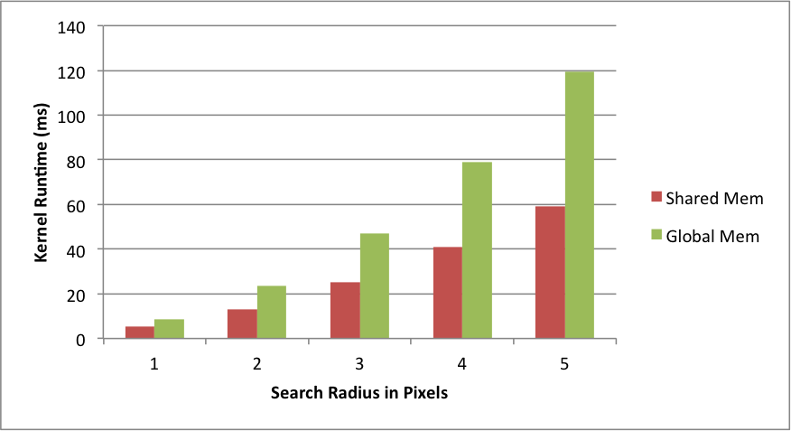
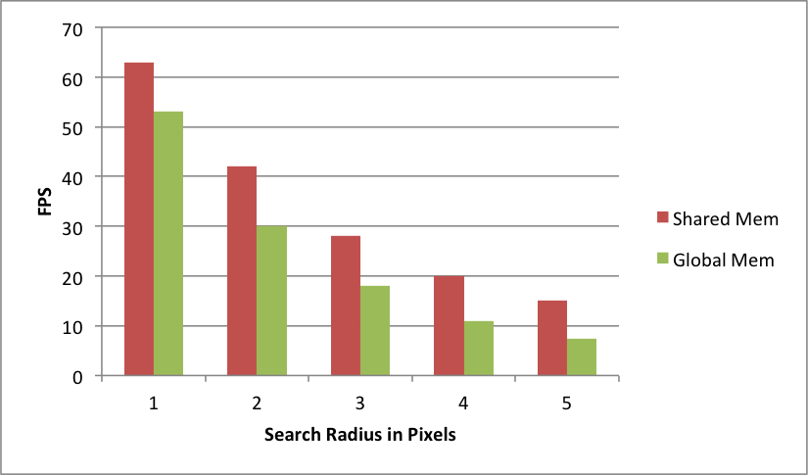
Performance Optimization
kernel execution time
frame rate (fps)

Slide 8
Mesh Reconstruction
High resolution mesh (all valid vertices)
Parameterize by triangle

Slide 9
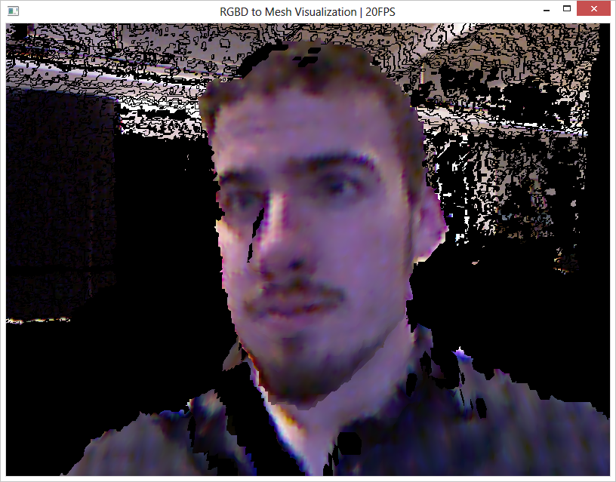
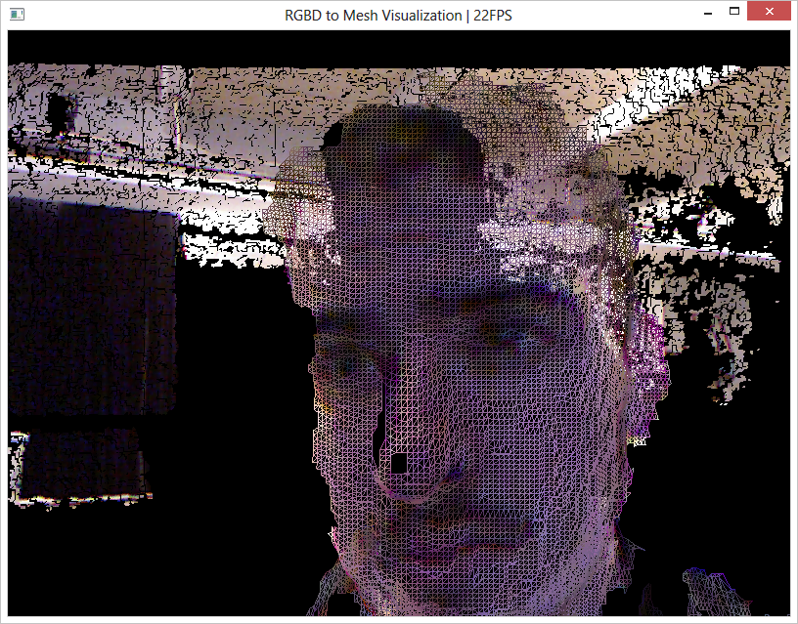
Mesh Reconstruction
High resolution mesh (all valid vertices)
Parameterize by triangle
filled
wire frame

Slide 10
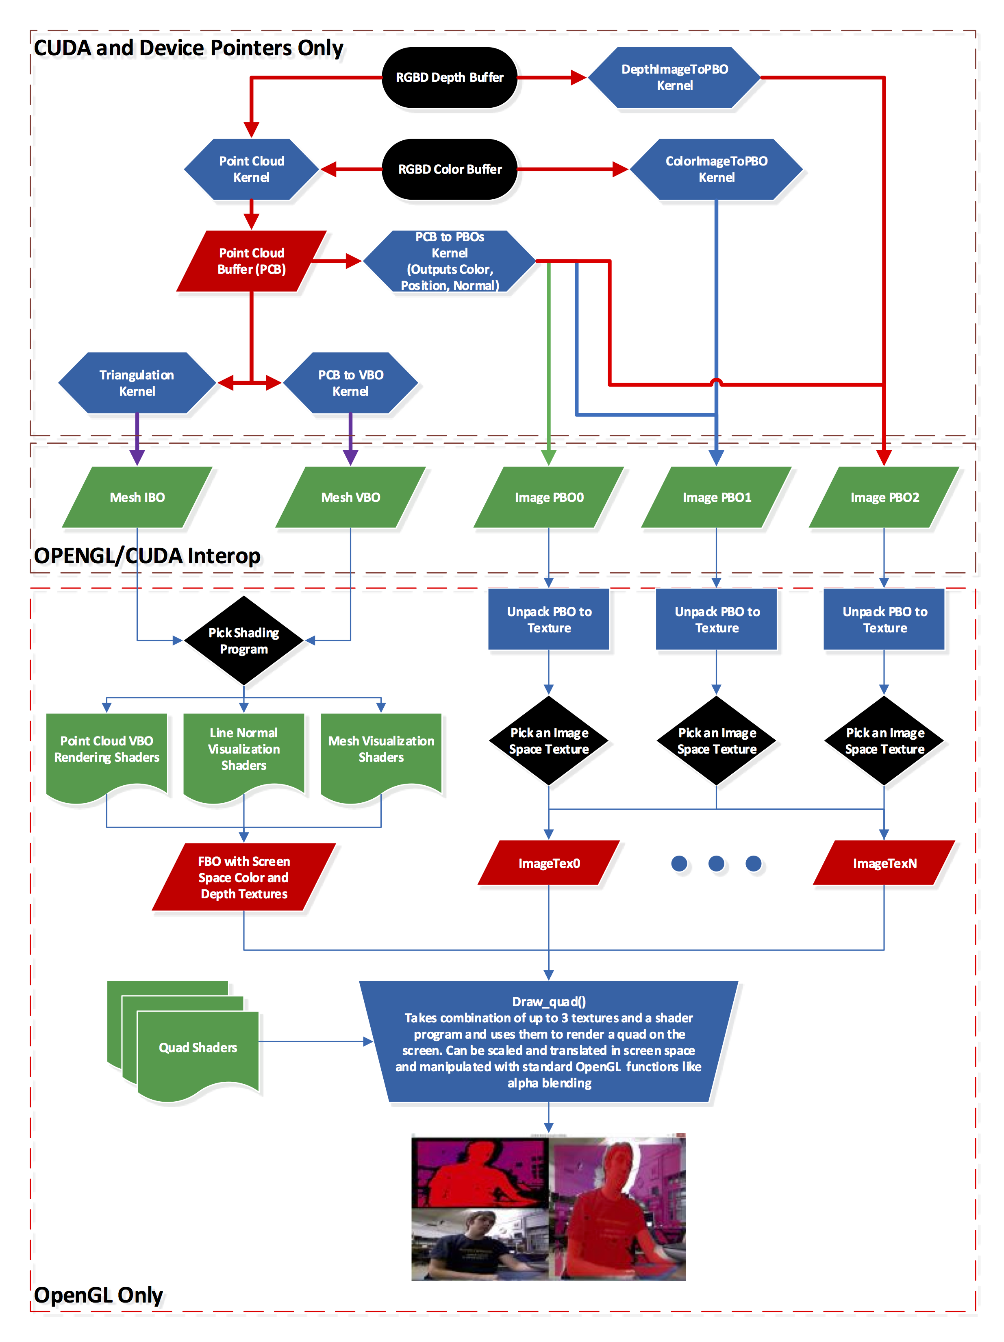
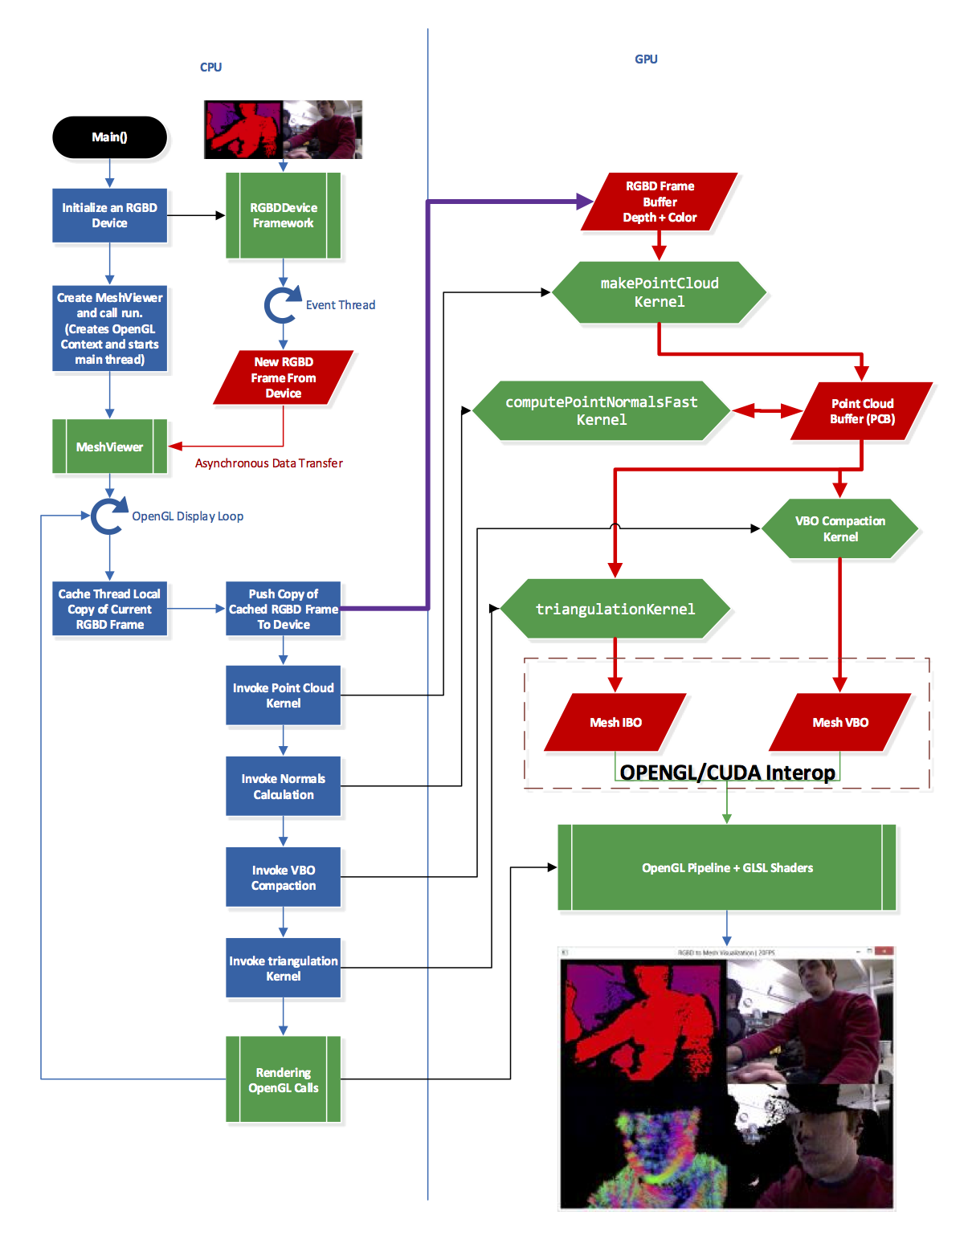
Full Pipeline / Interactive Shaders
program overview
rendering pipeline

Slide 11
Live Demo!

Slide 12
Future
Determine if improved normals are necessary for accurate surface reconstruction
Account for Kinect depth digitization
Adaptive mesh simplification
Poisson surface reconstruction?
Image registration and mesh merging

